Slide 1
Face Recognition using OpenCV
Aparna

Slide 2
Introduction
Face recognition is one of the most helpful non-intrusive biometric person identification tool that can be used today.
The idea of face recognition is widely popular because it can be applied in a mobile platform for not only identification or recognition, but other important aspects such as crowd control, robotics or even as a commercial identification or marketing tool.
This has several applications in security and surveillance, including automatic attendance systems, smart cities, home automation and secutrity etc.
The emerging technologies of VR and human-computer interactions that are being integrated in our everyday life, depend heavily on face detection and recognition systems.

Slide 3
Challenges
A structured face-only dataset (localized and cropped faces) is required for each identity in order to successfully learn discriminative features to recognize each person.
The primary challenge arises in learning a viewpoint invariant complete representation of the human face.
The recognition accuracy is severely affected with the alignment of the face to the camera, specially when instead of the frontal view, only a part of the face is visible.
Face recognition models still suffer from occlusion, rotation, illumination and scale variations etc.

Slide 4
Problem Statement
To successfully detect and recognize one or more faces in an image or a video stream with significant accuracy.
To establish the similarity between two faces based on some metric. When being presented with unknown faces, to be able to identify whether they belong to the same person or not.

Slide 5
Contribution
We define the significant contributions of our work as,
We employ a facial blob detection algorithm in both phases of training and recognition, and this leverages the dependency on structured face-only dataset.
Our model generates 128-dimensional facial embeddings from images to a Euclidian space, which is further optimized using a triplet loss function and introduce a novel mining strategy. A discriminative learning algorithm is implemented on top of this learned embedding space for better classification and recognition accuracy.
The architecture is modular, lightweight and can run in real time. The implementation is possible in both supervised and unsupervised setting.

Slide 6
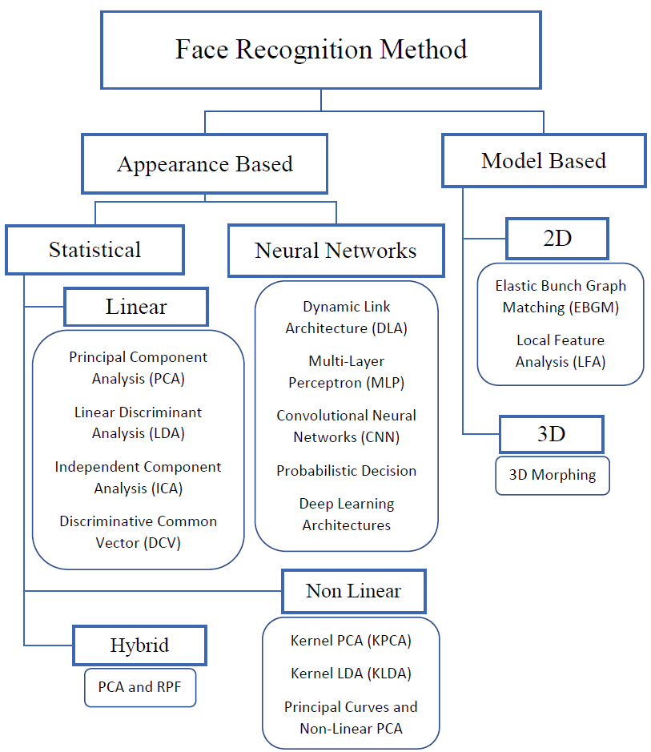
Literature Review
Since its inception a number of techniques have been proposed, which can broadly be classified as Appearance based and Model based.
The different methodologies and their developments are demonstrated.

Slide 7
Literature Review: Face Recognition Methods
Appearance Based Methods
Model based methods
These methods are focused on constructing a global image representation of the complete human face image in a vector space using some form of transformation, rather than using local facial features.
Features are directly derived from the pixel information, to capture the variance among different individual faces and are used to identify unique individuals.
Model-based methods aim to reconstruct a model of the human face that capture facial variations. Prior knowledge and structure of the human face is highly utilized in designing the model.
Model-based matching derives the distance and relative position features from the placement of facial elements (such as eyes, nose, lips etc.)

Slide 8
Literature Review: Face Recognition Methods – Appearance Based
Statistical Methods
Neural Networks
These methods use image transformation to generate representation to a vector space i.e. feature space from the high dimensional image space based on different statistical viewpoints.
The projection coefficients are used as the feature representation of each face image through the projection of the face vector onto the basis vectors.
The face image or the facial features is the input of the neural networks, that try to learn discriminative features space (vector space) boundaries in a multi-dimensional manifold in order to capture intra-class clustering and inter-class variation.
These do not use explicit transformation function, and the mapping is done by adjusting the network weights.

Slide 9
Literature Review: Appearance Based -Statistical Methods
Linear
Non-Linear
Hybrid
The transformation or mapping is linear. The vector space is simple
Principal Component Analysis (PCA),
Linear Discriminant Analysis (LDA),
Discriminative Common Vector (DCV) etc.
Uses non-linear transformation function which in turn generates a complicated subspace.
Kernel PCA (KPCA)
Kernel LDA (KLDA)
Principal Curves and Non-Linear PCA
The hybrid approach make use of both transformations at different stages of analysis.

Slide 10
Literature Review: Appearance Based –Neural Networks
Neural Networks grew rapidly in the last decade, and tremendous advancements are observed in the field of computer vision, specifically when dealing with large amount of image data.
Convolutional Neural Networks (CNNs) gave the advantage of automatically extracting feature vectors that capture the variability of data without any manual intervention.
These methods operate using a optimization function such as Stochastic Gradient Descent (SGD) that aims to find the global minimum of the loss function manifold.
The deep features can then be extracted from an intermediate layer, which can be used for matching i.e. recognition. They significantly outperform the traditional methods by a huge margin.

Slide 11
Literature Review: Deep Learning based Face Recognition
Deep learning methods, such as convolutional neural networks, use a cascade of multiple layers of processing units for feature extraction and transformation. They learn multiple levels of representations that correspond to different levels of abstraction.
The levels form a hierarchy of concepts, showing strong invariance to the face pose, lighting, and expression changes.
The initial layers learn the primary features such as edges, texture etc. and the higher layers learn the object shapes, colour etc.

Slide 12
Literature Review: Deep Learning based Face Recognition
Deep Learning based methods primarily consists of two stages, (1) Deep Feature Extraction, and (2) Face Matching i.e. Recognition
Feature extraction methods generally use a backbone CNN architecture such as AlexNet, VGGNet, GoogleNet etc. trained on a large scale image database such as ImageNet as a baseline and finetune the model based on facial images.
However, with increasing datasets on human faces, many novel architectures are being designed specific to face recognition. An ensemble of networks, each having specific tasks, are also used in face recognition tasks.
Recognition: After the deep networks are trained with massive data and an appropriate loss function, each of the test images is passed through the network to obtain a deep feature representation.
Once the deep features are extracted, most methods directly calculate the similarity between two features using cosine distance or L2 distance; then, the nearest neighbour (NN) and threshold comparison are used for both identification and verification tasks.

Slide 13
Literature Review: Deep Learning based Face Recognition
Szegedy et al. proposed the GoogleNet Architecture based on the ‘Inception’ module, which won the ImageNet Challenge in 2014.
CNNs have shown accuracy improvements when using a deeper architecture, but simply stacking layers one after another gives rise to computational problems such as Overfitting and Vanishing Gradient during backpropagation.
The Inception module makes use of 1x1convolutional layers in front of the 3x3 and 5x5 convolutional layers in parallel to reduce the dimensionality and then use filter concatenation. This increases sparsity constraints that overcome the problems of traditional deep networks.
This implementation is effective in reducing model parameters while giving benefits of the very deep architectures, and this is the main reason we have used the Inception module extensively in our model architecture.

Slide 14
Methodology
The proposed face recognition pipeline runs through four primary steps:
Detection of faces from images
Generating face embeddings from the detected faces
Training a classification model based on the face embeddings
Prediction/Matching of any unknown face image
We will go through the basic building blocks of our model, an explain in detail the theory behind each component.

Slide 15
Methodology: Face Detection
Image preprocessing
Image resizing
Mean subtraction and scaling
Face detection methodology
Pretrained Caffe based object detector using the ResNet architecture
OpenCV implementation is used off the shelf

Slide 16
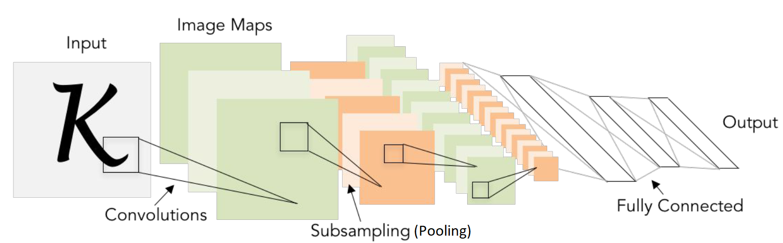
Methodology: Model Architecture
Our face recognition model is developed on Convolutional Neural Networks (CNNs), that have revolutionised the world of computer vision.
CNN has four main components:
(1) Convolution layer,
(2) Activation function,
(3) Pooling layer, and
(4) Classification layer (Fully connected network).

Slide 17
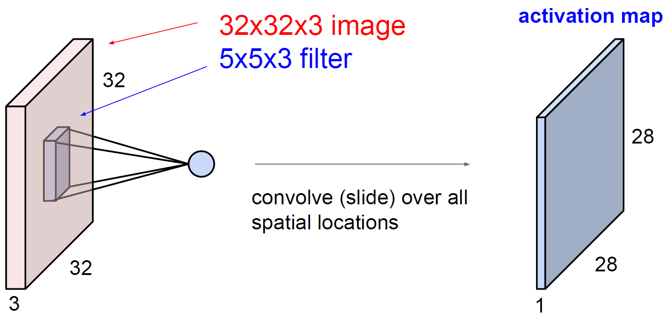
Methodology: Model Architecture – Convolution layer
The primary purpose of Convolution in case of a CNN is to extract features from the input image
Convolution preserves the spatial relationship between pixels by learning image features using small squares of input data.
A filter slides over the input image (convolution operation) to produce a feature map.
The Convolution operation captures the local dependencies in the original image.
Different filters generate different feature maps from the same original image
The size of the Feature Map (Convolved Feature) is controlled by three parameters: (1) Depth, (2) Stride, (3) Zero-padding.

Slide 18
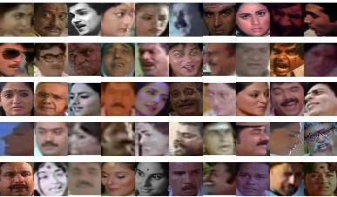
Dataset
Indian Movie Face database (IMFDB)
A large unconstrained face database consisting of 34512 images of 100 Indian actors collected from more than 100 videos.
All the images are manually selected and cropped from the video frames resulting in a high degree of variability and diversity.

Slide 19
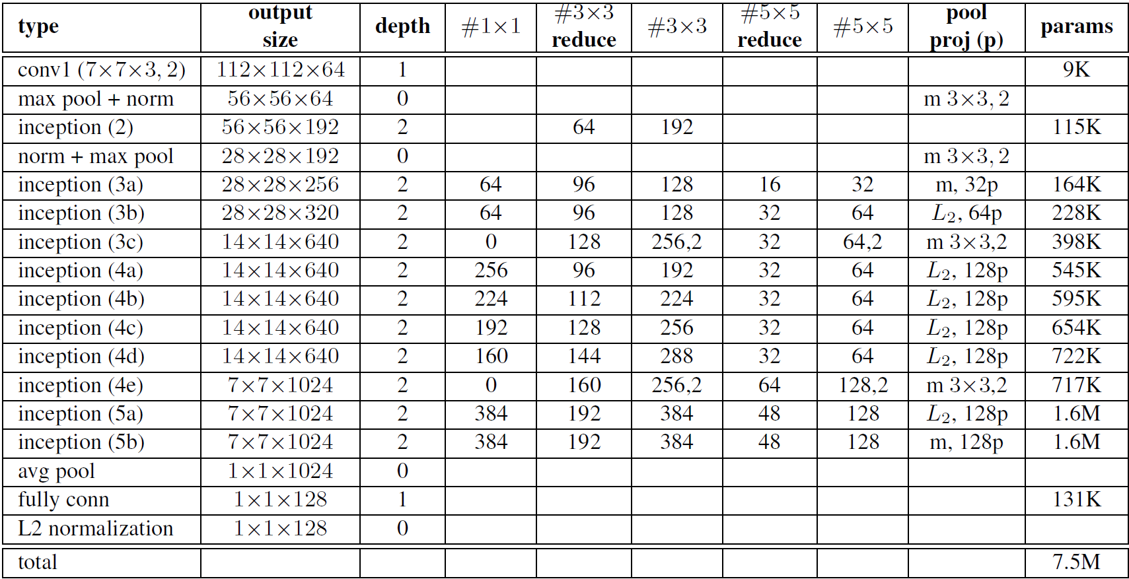
Model implementation

Slide 20
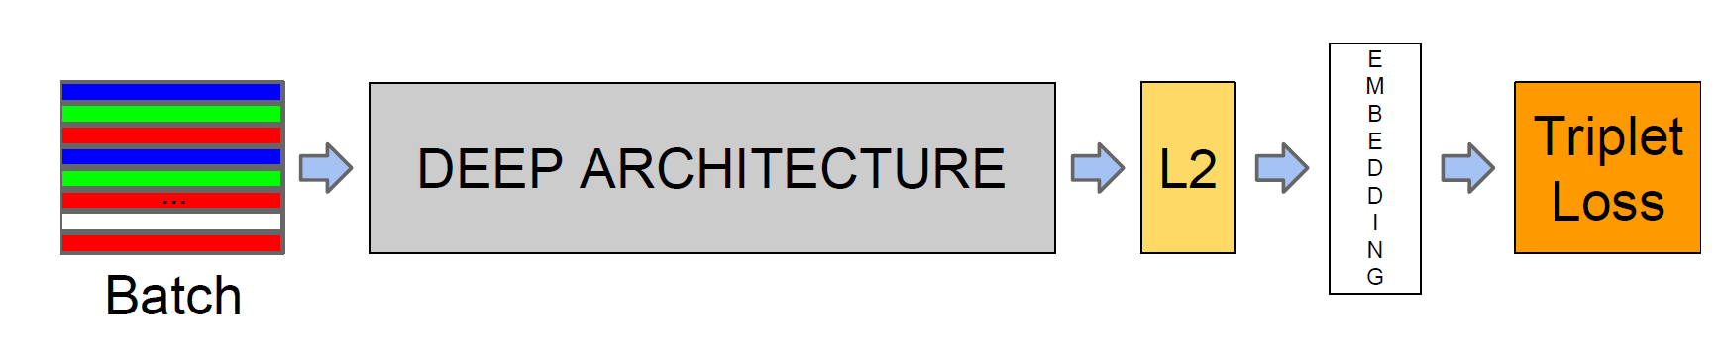
Model structure

Slide 21
Results and Discussion: Training and Testing on actor faces
Training Methodology
Dataset
Face Detection
Face Embedding
Generating feature maps
ML algorithm
Learning to identify individuals

Slide 22
Results and Discussion: Training and Testing on actor faces
Testing Methodology
Movie clips
Face Detection on each frame
Face Embedding
Generating feature maps of the detected faces
ML algorithm
Prediction of actor identity
Results
Displaying the localised results

Slide 23

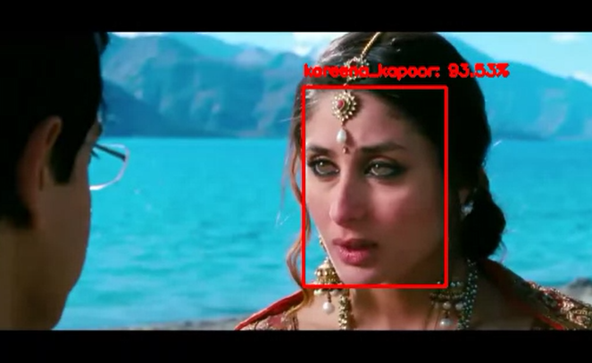
Results and Discussion: Test Results
The face of Aamir Khan is detected with an accuracy of 94.53%
The face of Kareena Kapoor is detected with an accuracy of 93.53%.

Slide 24
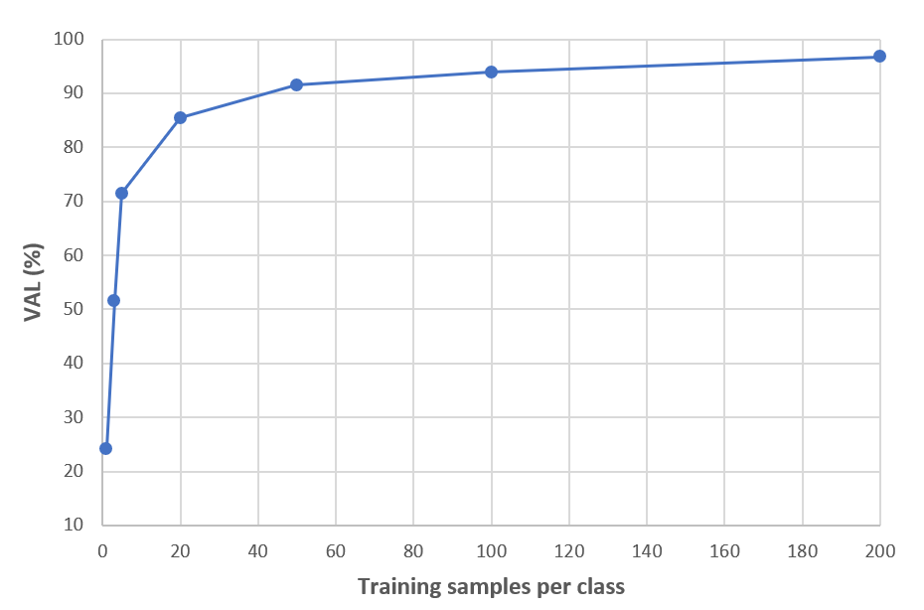
Results and Discussion: Effect of increasing training data
The recognition accuracy increases with an increase of training samples per person.
With a training sample of 20 per person, accuracy of 87% can be achieved.
However, this increase saturates with very high number of samples.

Slide 25
Conclusion
The slides says that the whole process can be applied to many scenarios like into the Crime Department in identifying a particular criminal or tracing them
A particular kind of abnormal heart beat in the heart rate signal to identify the severity of the disease or the abnormality and to predict if any fatality is going to happen to that particular patient
The Algorithm that will be applied will be using the concepts of Deep Neural Networks specifically CNN to extract the best features of the database and get the better model performance

Slide 26
Future Work
Future work will focus on further improving the model through better understanding of the error cases. Also, we would like to achieve reduction in model size and increase computational efficiency.
Improvement in terms of training time is another way of work we would like to explore by varying our learning curriculum with different batch sizes and offline as well as online positive and negative mining.

